Slide 1
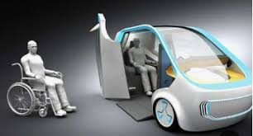
Team 15:
Vehicle Guardians
MOVE AROUND
WITH EASE

Slide 2



The Numbers and Problem
30 million people have hearing impairment
23 million Americans have vision impairment
3
million us a wheelchair full-time
Problem:
Vision, hearing and physically impaired people having trouble getting around using internal communications in vehicles.

Slide 3
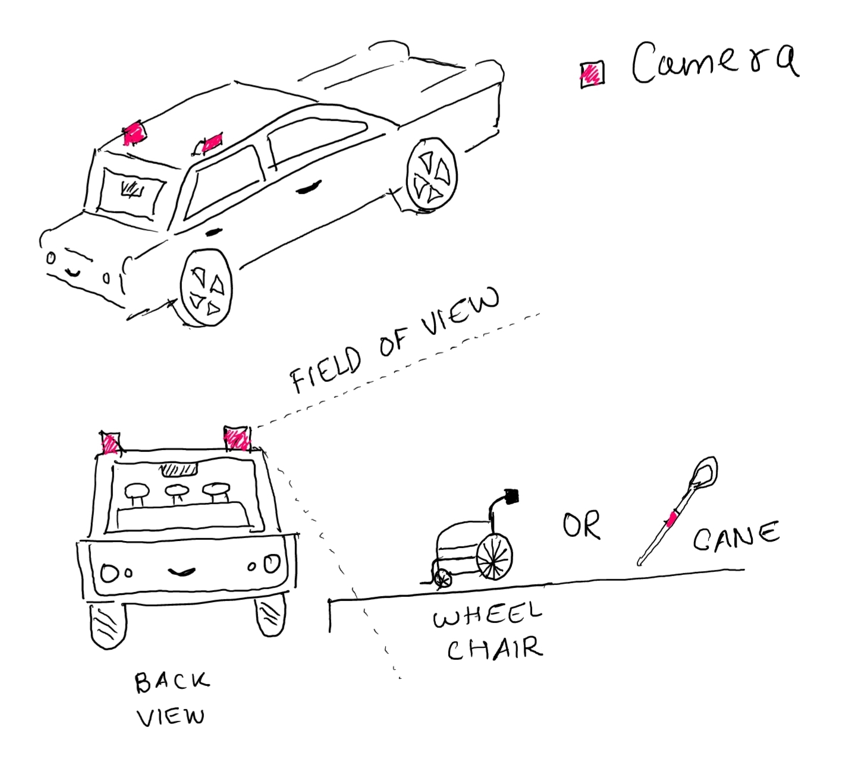
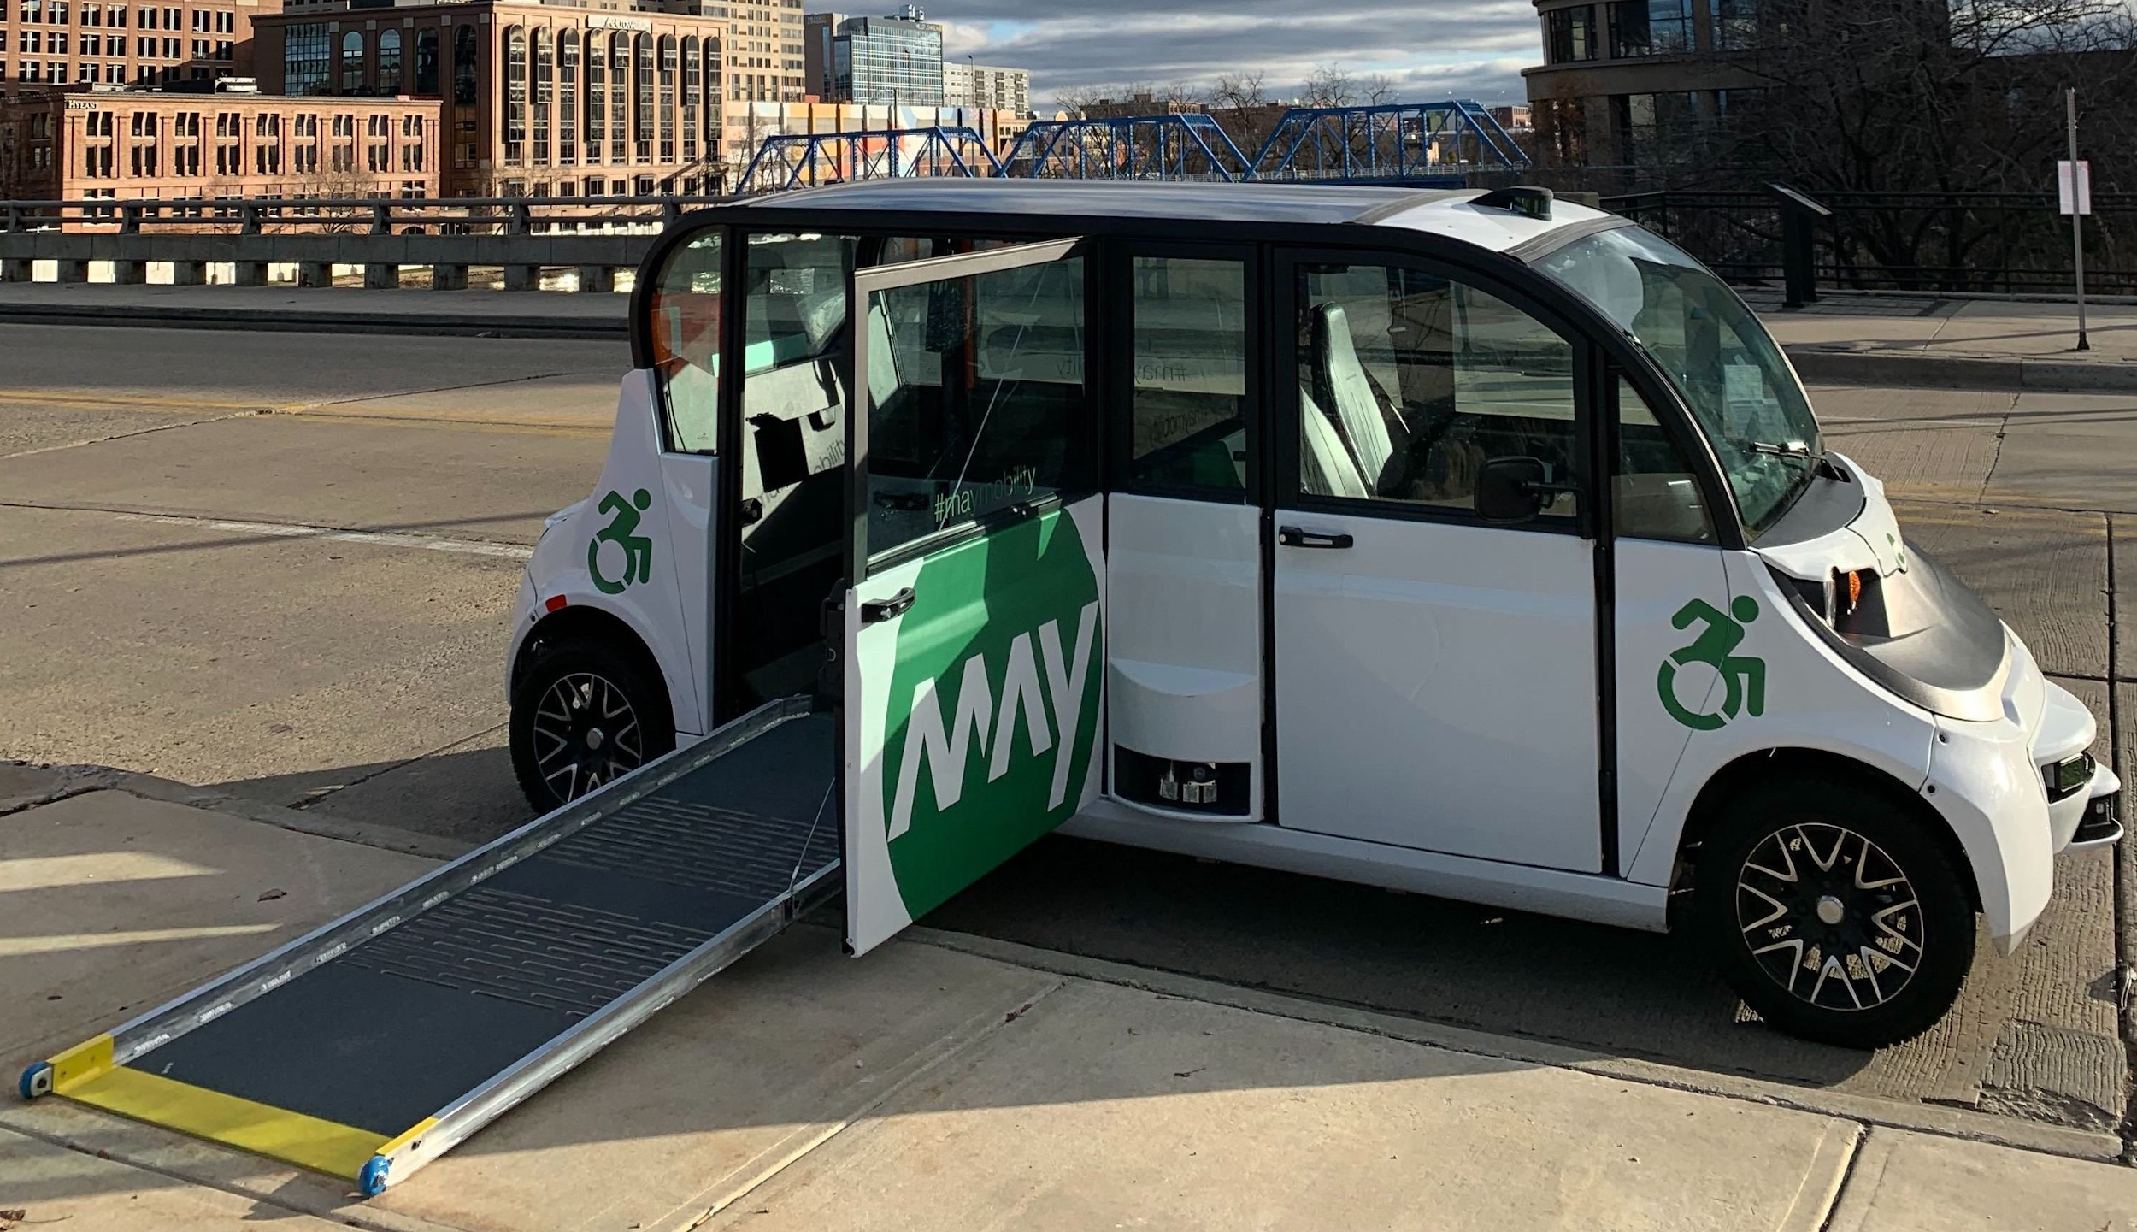
The Solution
Pre-boarding
Cameras mounted on top of the autonomous vehicle
Image processing disability algorithm detection will be implemented to detect wheelchair and passengers with cane(using a Deep learning algorithm)[1].

Slide 4
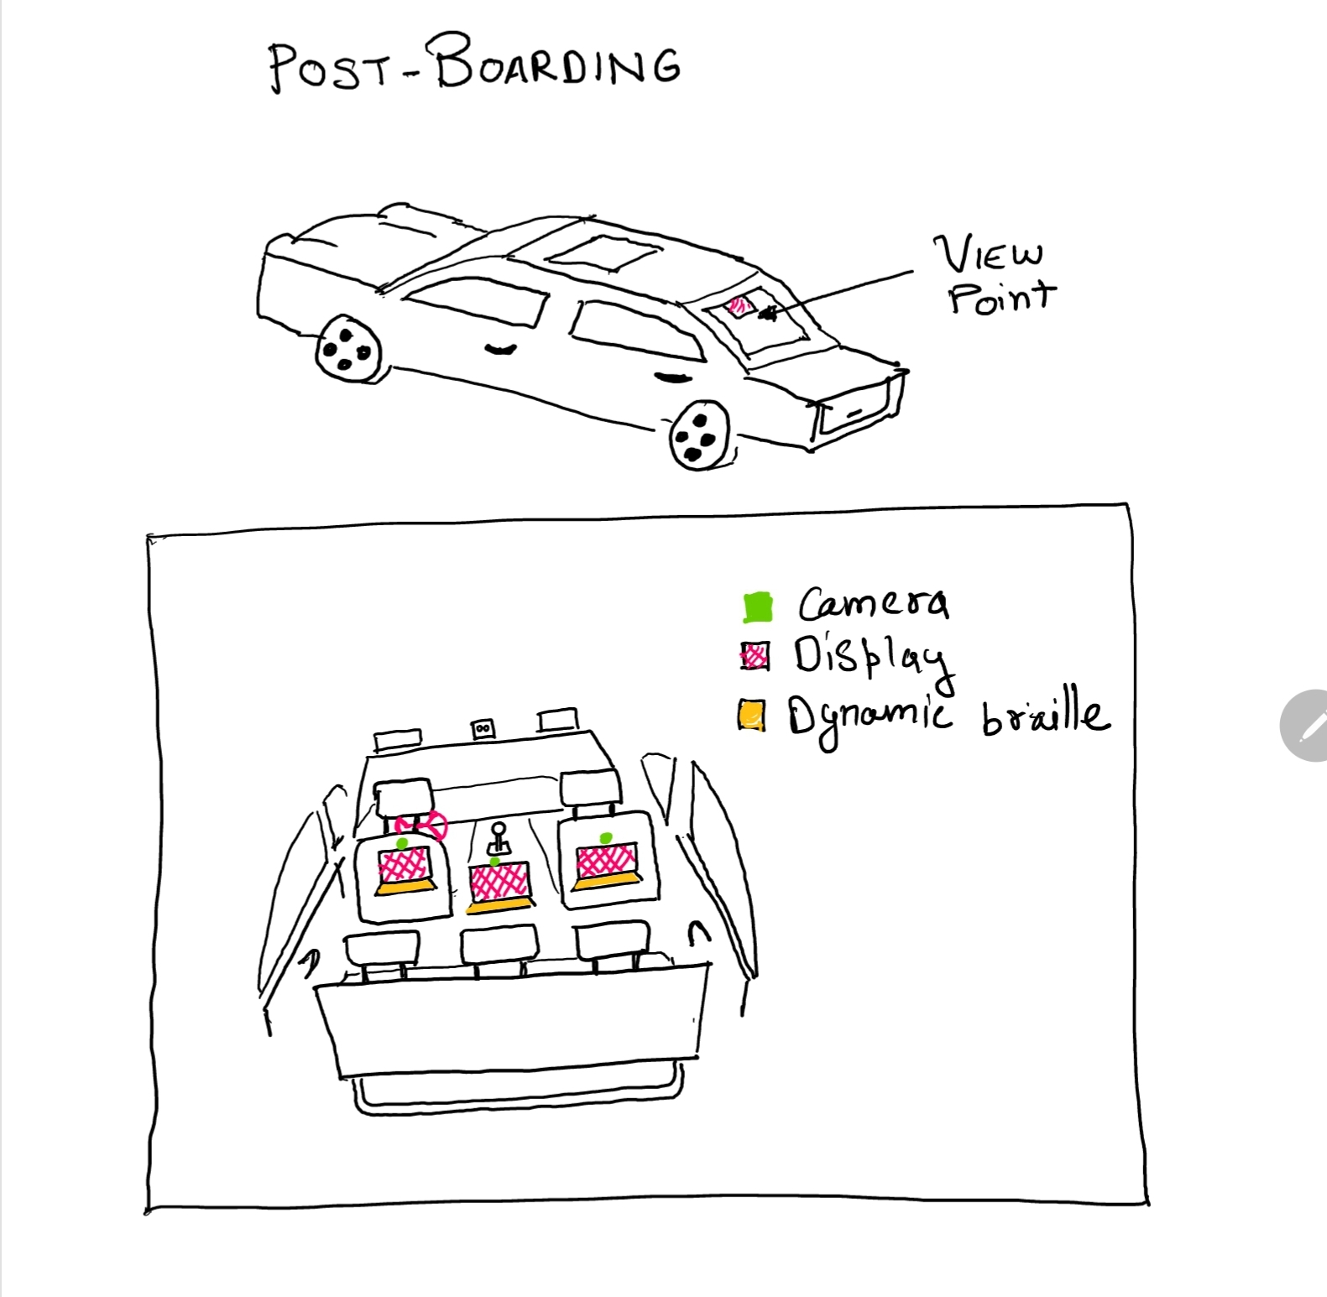
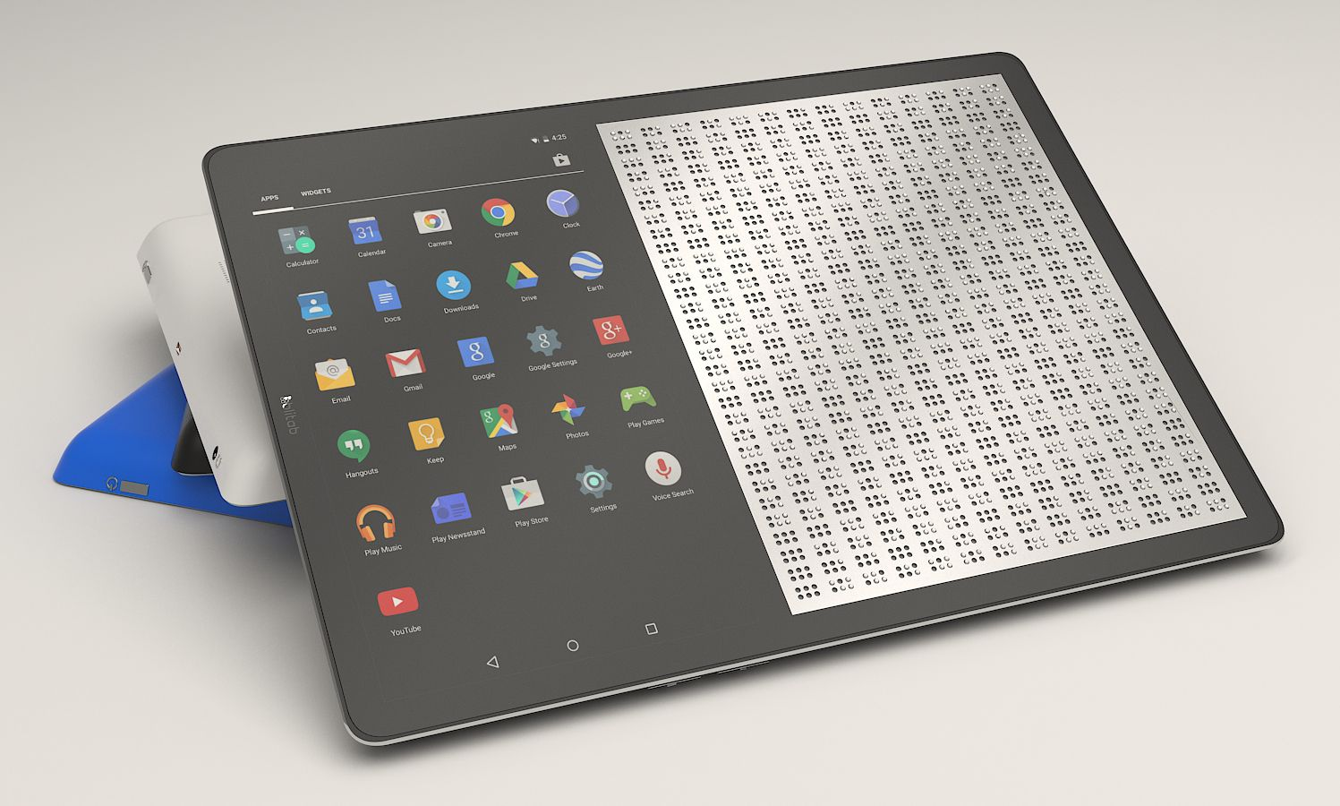
The Solution
Post- boarding
Display
Dynamic Braille [2]
Camera (computer vision and image processing algorithm [3])
Speaker
Microphone (using speech recognition [4])
Oscillator/Piezoelectric (vibration)
Virtual guardian assist

Slide 5
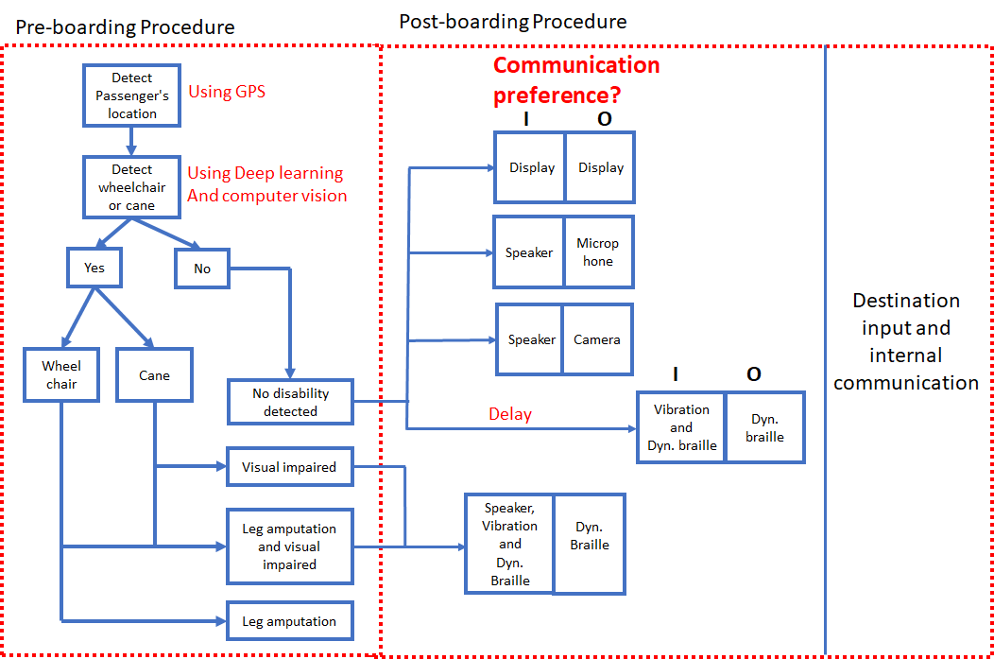

Slide 6
Economics: Cost of our solution
Items | Quantity | Price (per)
Dynamic Braille tablet | 3 | $500
Camera | 5 | $150
Speaker (optional) | 1 | $100
Mic | 1 | $70
Processor | 1 | $99
SSD | 1 | $100
Total |  | $1019

Slide 7



Next steps
Pilot program in US to refine our algorithms which will be implemented in the AV
Spread our internal communication solution to other countries
BUILD
LAUNCH
PILOT
SPREAD
Implement the devices and run the algorithms in AV.
Expand across the US after beta testing

Slide 8




Competitors and Market Uniqueness

Slide 9
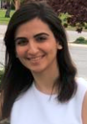

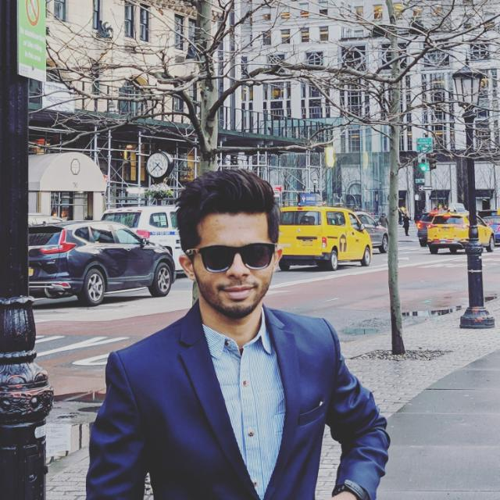
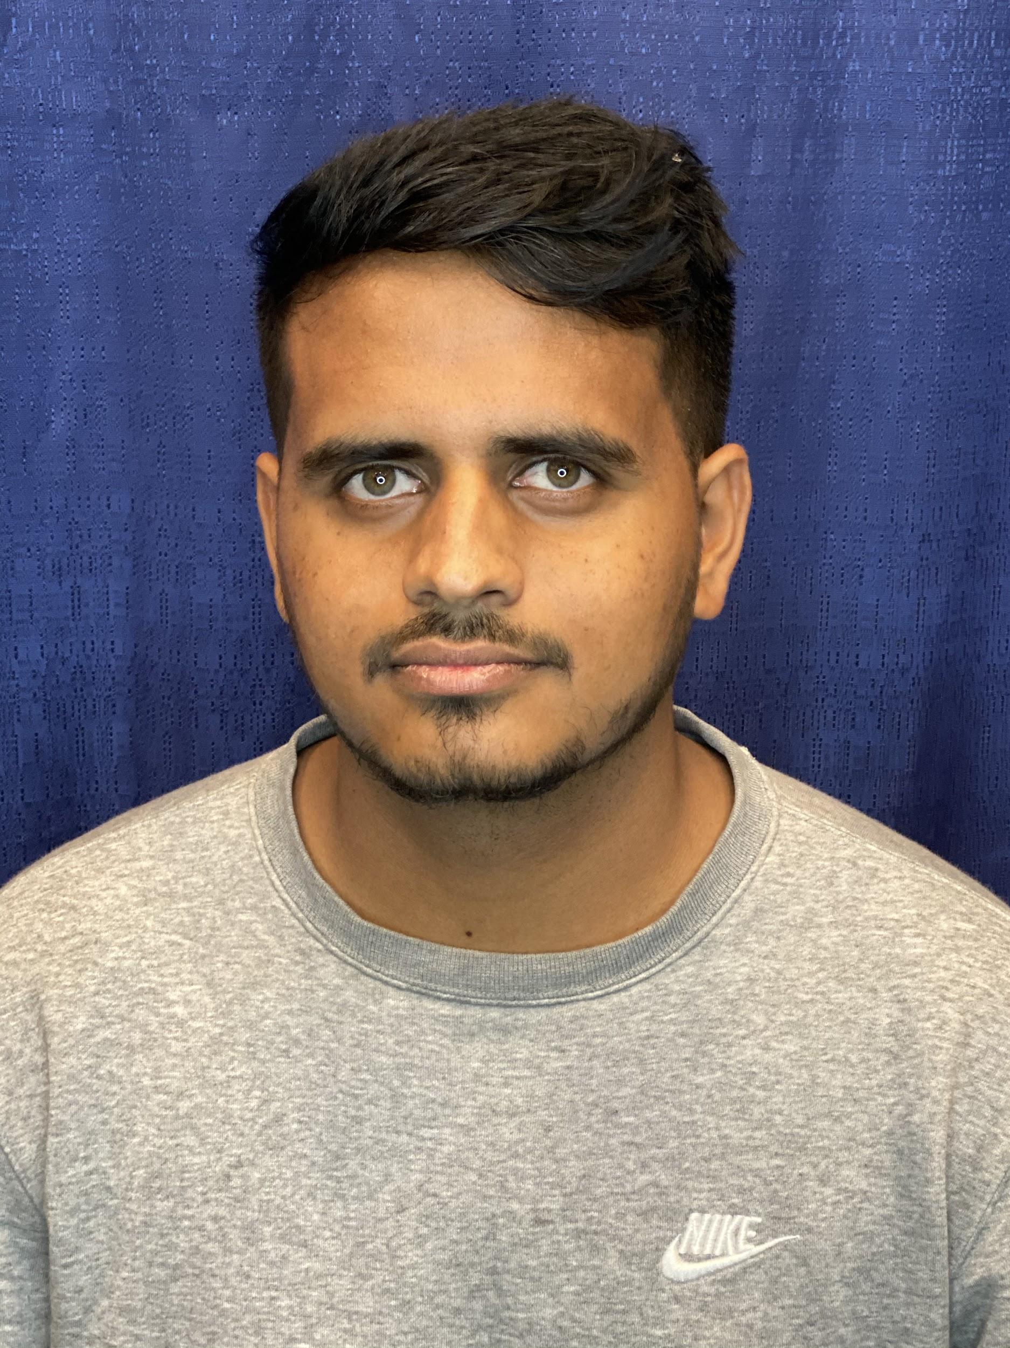
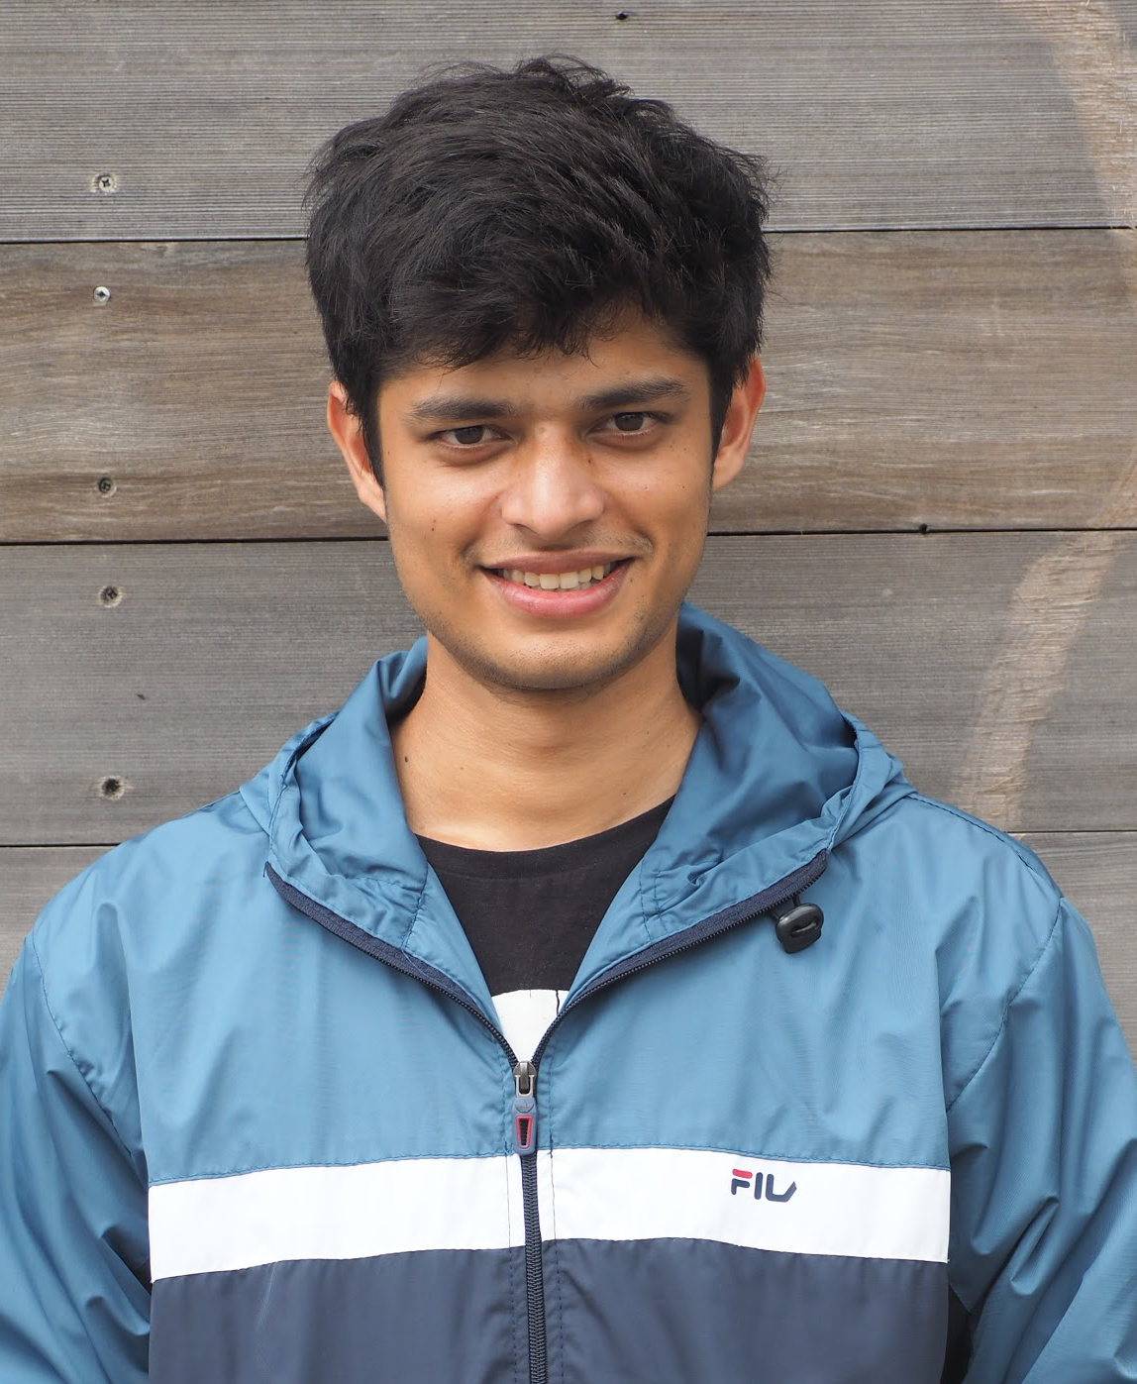
Our diverse and driven team
Lama Moukheiber
Biomedical
Engineer
Rishabh Sharma
Engineering Sciences specialization in Robotics
Akhil Reddy
Artificial intelligence & Robotics
Saurabh Mahindre
Data Science
Vinay Sudarshana
Computer Science &
Engineering
MOVE AROUND
with ease
Mentors: Randall Duchesneau
Alexander Ding

Slide 10
References
[1] Erhan, Dumitru, et al. "Scalable object detection using deep neural networks." Proceedings of the IEEE conference on computer vision and pattern recognition. 2014.
[2] https://blitab.com/
[3] I. Imagawa, H. Matsuo, R. Taniguchi, D. Arita, Shan Lu and S. Igi, "Recognition of local features for camera-based sign language recognition system," Proceedings 15th International Conference on Pattern Recognition. ICPR-2000, Barcelona, Spain, 2000, pp. 849-853 vol.4, doi: 10.1109/ICPR.2000.903050.
[4] Scagliola, Carlo. "Language models and search algorithms for real-time speech recognition." International Journal of Man-Machine Studies 22.5 (1985): 523-547.

